Slide 1
The US Army’s Physical Fitness Test (APFT) in Infantry Basic Training
An exploration on why there is a high initial high failure rate and what can be done to lower the failure rate
By Thompson C. Liu

Slide 2
Thesis
Can we predict pass or fail by only looking at specific exercises within the APFT?

Slide 3
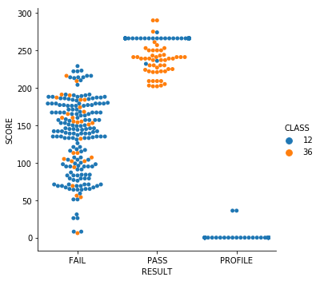
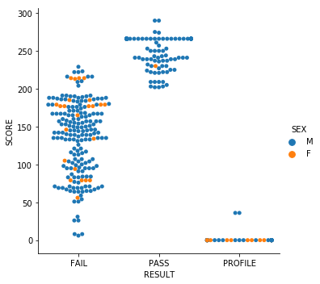
Current Initial APFT Score

Slide 4
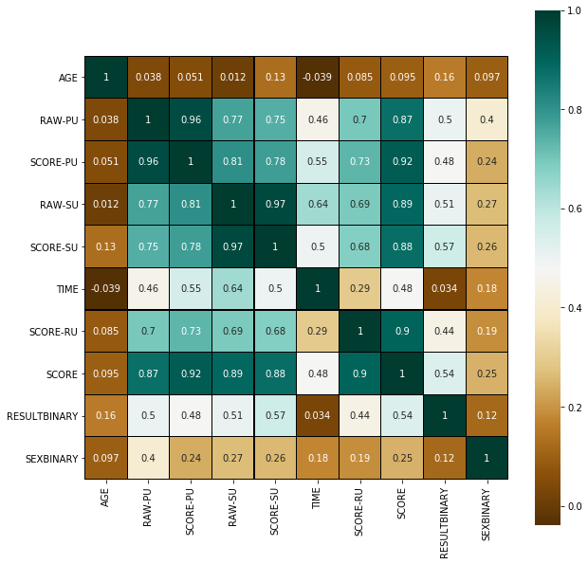

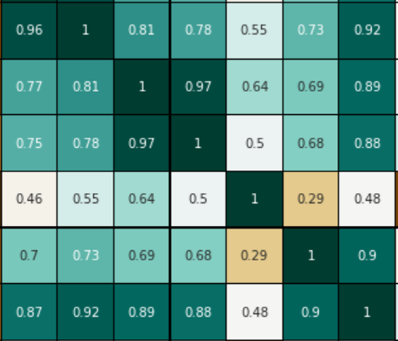

What are the Important Factors in the APFT?

Slide 5
Logistics Regression Estimated Coefficients
Param: C=100
Coefficients Train
[[ 0.10021598 0.25542059 -3.01614361]]
[-14.53006186]
Coefficients Test
[[ 0.15628008 0.26641391 -2.34340151]]
[-18.32621031]
Accuracy of PASS status
RESULTBINARY 0 1
row_0
0 62 1
1 4 69
Percentage accuracy
0.9520295202952029
Percentage accuracy
0.9632352941176471
array([1. , 1. , 1. , 0.92592593, 0.92592593])
Notes:
BOLD: Triggers exponential growth. 1 Unit increase in sit-up, leads to a .12 increase overall
Data by design is classified very clearly (result binary)

Slide 6
Lasso Regression
R² for the model with training model:
0.5569889792612555
Parameter estimates for the model with few features:
[ 0.00746823 0.01078327 -0. -0.28125652]
R² for the test model:
0.6011184842157854
Parameter estimates for the model with many features:
[ 0.00422301 0.01332148 -0. -0.25294152]

Slide 7
Models which were not optimal
Linear Regression
Dependent variable is categorical
Lack of Linear Relationship
Decision Tree
High R^2: .988
Random Forest
Did not reduce R^2
High R^2: .963

Slide 8
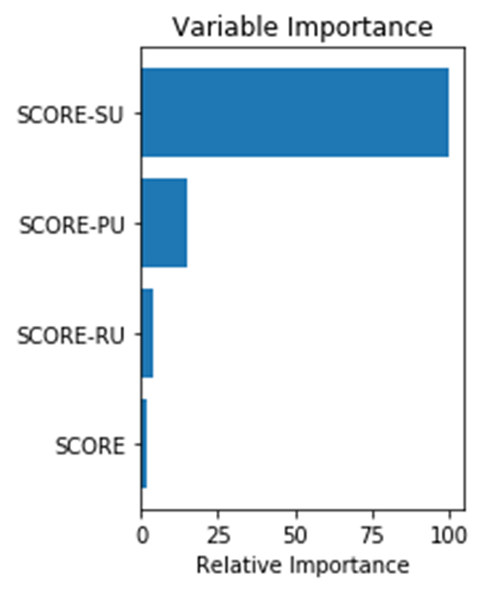
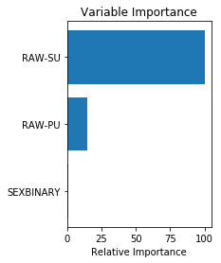
Variable of Importance

Slide 9
Limitations
Lack of data for costs of Soldiers who are on profile
The dependent variable was converted to binary
Not enough female Soldiers to accurately make a determination
Due to the class imbalance between Pass and Fail(to include Profile) down sampling was utilized.
Down sampling gender would not have been accurate due to the lack in size of the female populations
There are limitations to utilizing real data sets
Cleaning data is difficult
Attempting to extract insights that may not exist

Slide 10
Recommendations
Failures of the initial APFT should be put into a separate Basic Training Company.
Failures should work more on their Sit-ups to prevent injury as well as improve their overall score.

